Slide 1
Pens and Printers was founded in 1984 and provides high quality office products to large organizations. We are a trusted provider of everything from pens and notebooks to desk chairs and monitors. We don’t produce our own products but sell those made by other companies.. We have built long lasting relationships with our customers and they trust us to provide them with the best products for them. As the way in which consumers buy products is changing, our sales tactics have to change too. Launching a new product line is expensive and we need to make sure we are using the best techniques to sell the new product effectively. The best approach may vary for each new product so we need to learn quickly what works and what doesn’t.
Pens and Printers
BY
SALAMI LUKMAN BAYONLE
ON 13Th May 2023

Slide 2
Overview
Our focus has been on selling products to enable our customers to be more creative, focused on tools for brainstorming. We have tested three different sales strategies for this, targeted email and phone calls, as well as combining the two as follows;
1. Email: Customers in this group received an email when the product line was launched, and a further email three weeks later. This required very little work for the team.
2. Call: Customers in this group were called by a member of the sales team. On average members of the team were on the phone for around thirty minutes per customer.
3. Email and call: Customers in this group were first sent the product information email, then called a week later by the sales team to talk about their needs and how this new product may support their work. The email required little work from the team, the call was around ten minutes per customer.
The Problem
How many customers were there for each approach?
What does the spread of the revenue look like overall? And for each method?
Was there any difference in revenue over time for each of the methods?
4. Based on the data, which method would you recommend we continue to use? Some of these methods take more time from the team so they may not be the best for us to use if the results are similar.

Slide 3
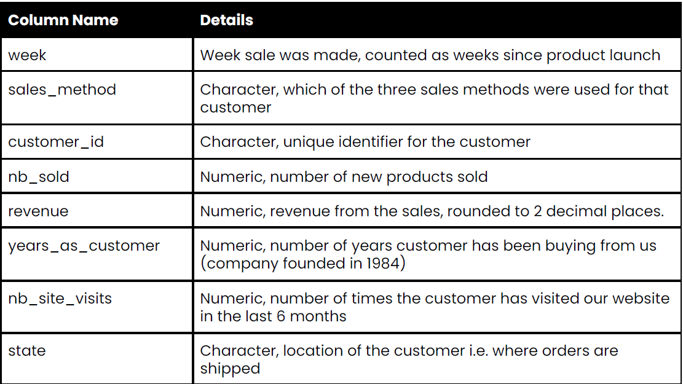
Data Validation

Slide 4
Data Validation
1. The Data was loaded using python pandas module in a jupyter notebook.
2. The data has 15000 rows and 8 columns.
3. The sales_method, customer_id and state columns are object type while the rest columns are either integer or float.
4. They are no duplicates in the dataset.
5. The revenue column had 1074 null values. The 'revenue' column is right skewed with outliers. So, we use median of the distribution as our imputation.
6. The years_as_customer column (company founded in 1984). Some years were greater than the year the company was founded. Those years were clipped to the maximum year since company was founded which is 39 years ago.
7. The sales_method column were listed in one of five (5) possible groupings instead of three (3) possible groupings of Email, Email+Call and Call. The column was cleaned. We have 3 possible groupings after cleaning.
7. The other columns week, customer_id, nb_sold, nb_site_visits and state were as presented

Slide 5
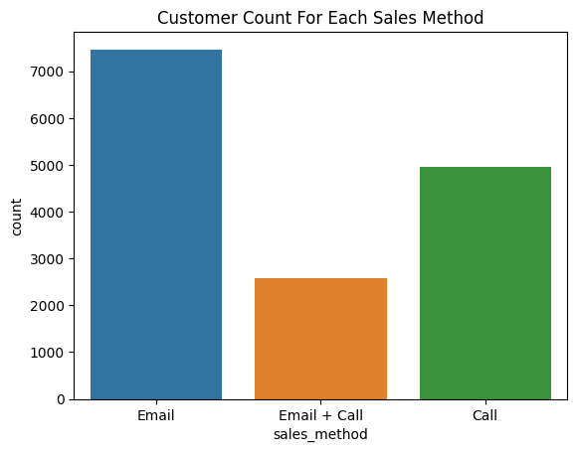
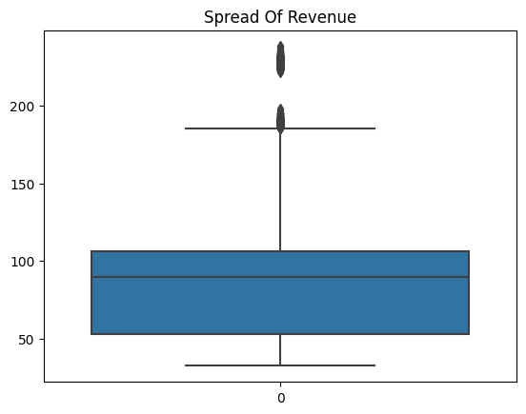
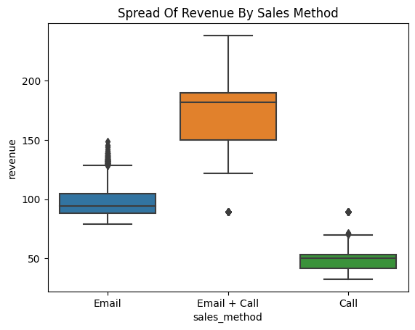
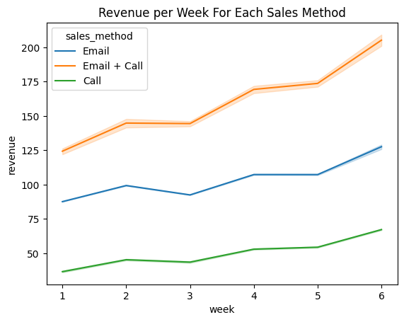
Exploratory Data Analysis

Slide 6
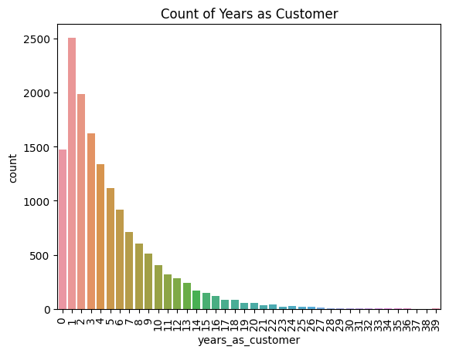
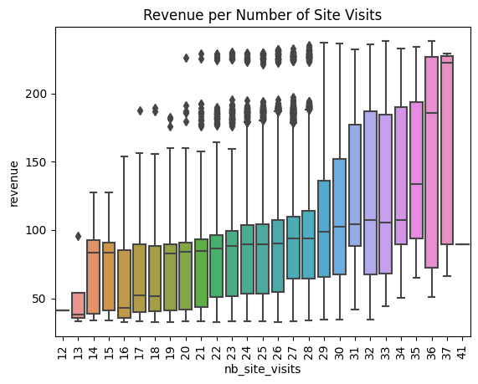
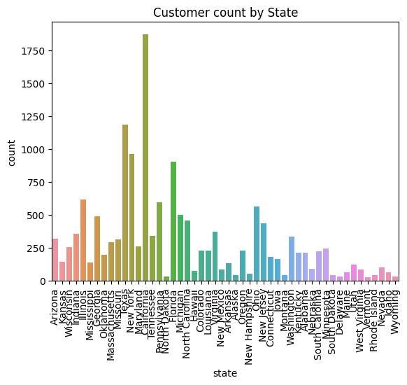
Exploratory Data Analysis

Slide 7
Findings
1. Customers per each sales method approach are 7466 (50%) customers for Email sales method approach, 4962 (33%) customers for Phone Call sales method appraoch, and 2572 (17%) customers for a combination of Email and phone Calls sales method approach.
2. Revenue is right skewed with outliers on the upper quartile. It has a mean of 93.62, median of 89.5, maximum value of 238.32, and minimum value of 32.54.
3. Email+Call sales method generates the most revenue followed by Email sales method and the least revenue generated is Call sales method.
4. Revenue increases per week for all the sales methods, with the Email+Call having the largest revenue growth per week followed by Email sales method.

Slide 8
Definition of a metric for the business to monitor
Definition of a metric for the business to monitor
1. The business goal has been on selling products to enable their customers to be more creative, focused on tools for brainstorming. They have tested three different sales strategies for this, targeted email and phone calls, as well as combining the two.
2. The Key Perfomance Indicators (KPI) in this case is the revenue generated and customer engagement/conversion rate from the sales methods of Email, Email+Call and Call.
3. Establish a baseline: From the current data provided the customer engagement/conversion rate are 7466 (50%) customers for Email sales method approach, 4962 (33%) customers for Phone Call sales method appraoch, and 2572 (17%) customers for a combination of Email and phone Calls sales method approach.
4. With our baseline we can monitor the revenue generated from each sales method. With current data provided we noticed that customer engagement/conversion rate is 17% for Email+Call but it generated the highest revenue.

Slide 9
Summary
Customers per each sales method approach are 7466 (50%) customers for Email sales method approach, 4962 (33%) customers for Phone Call sales method appraoch, and 2572 (17%) customers for a combination of Email and phone Calls sales method approach.
Email+Call sales method generates the most revenue followed by Email sales method and the least revenue generator is Call sales method.
Revenue increases per week for all the sales methods, with the Email+Call having the largest revenue growth per week followed by Email sales method.
Customer number has increase over time. With more customer joining the company in the last ten years.
The higher the number of times a customer visited the website in the last 6 months, the higher the revenue.
Maryland has the highest number of customers.
Recommendation
1. We will recommend the use of Email+Call sales method as this method has substantial revenue growth per week and the highest revenue. More effort should be on the Email+Call. With just 17% customer engagement/conversion rate it still generated the highest revenue.
2. We will also recommend the continue use of Email sales method as this method has a better revenue growth per week, a 50% customer engagement/conversion rate, and the second highest revenue after the Email+Call. It is far better than the Call sales method
3. The Email+Call sale method requires an email at product launch and a ten minutes calls a week after which is a decent effort when comapred to the revenue

